Slide 1
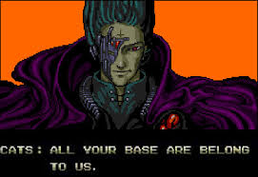
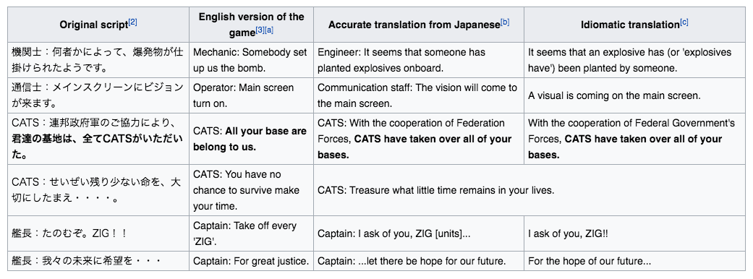
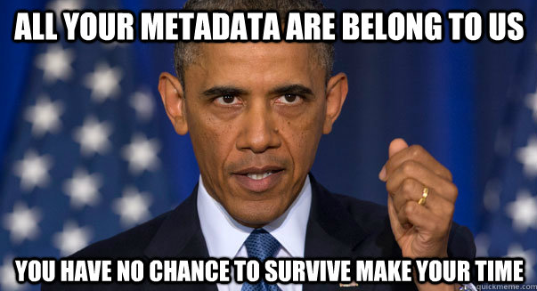

All Your Base Are Belong to Taco Bell
Transcript…
1989 Arcade Game Zero Wing
Taco Bell –
Only in America
Memes…

Slide 2
All Your Base Are Belong to Taco Bell
Team
Paul Dix, Matt Koster, Scott Seifert,
Patrick Kaufman, Derek Higgins, Jeff Rose

Slide 3



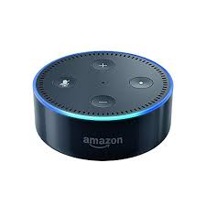

Start Your Day With Virtual Coach
Client Building and Pipeline Management in 2017…
Quick
Concise
Impactful
Financial Representative at Breakfast

Slide 4
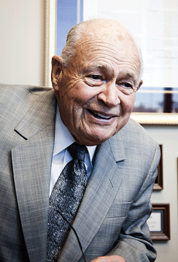
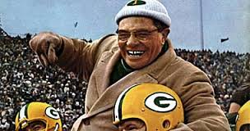
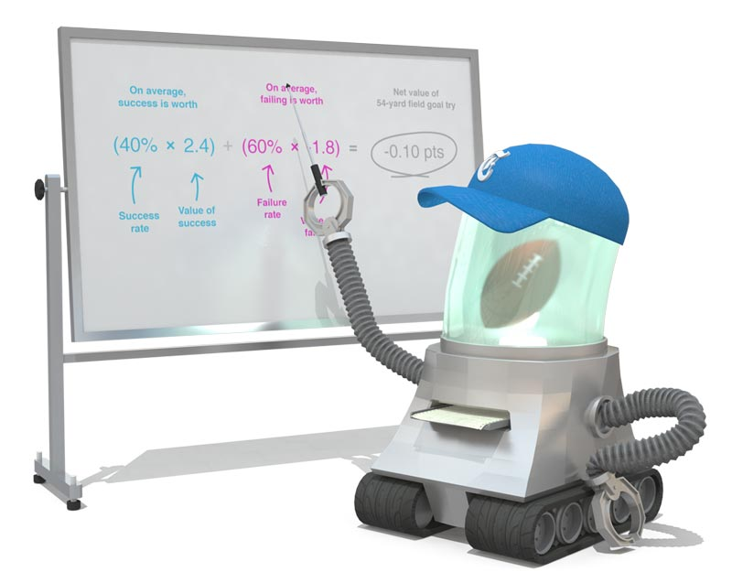

Virtual Coach
Al Granum – Father of the One Card System. Client Builder extraordinaire!
Vince Lombardi – The coaches coach. The greatest coach in football history!
Bots – An intelligent personal assistant (i.e. Bot) with Analytics
10-3-1. It takes 10 leads (suspects) to generate three prospects (who participate in full fact finding), and one of them will become a client.

Slide 5




Virtual Coach Capabilities
Activities
Quarterly Reviews
Age Changes
Initial Calls to Qualified Suspects
Dinner Socials
Happy Birthday Lunch
Etc.
Opportunities
Prepare Plan
Asset Transition
Complete Paperwork
Policy Delivery
Etc.
Goals
Daily Activities Goal
Monthly Fact Finder Goal
Monthly Qualified Suspects Goal
Complete Paperwork
Etc.
Example: Planning
Example: 65 Life Sale
Rep Productivity

Slide 6
Appendix

Slide 7

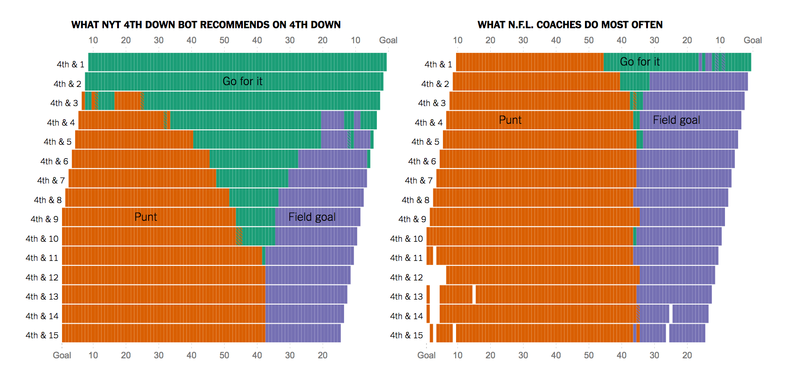
Compare: NFL and the 4th Down Bot
Bot Recommends - Go for it!
Coach Recommends - Punt
Good Analytics helps you make good choices!
Stats from 2002 - 2013
http://www.advancedfootballanalytics.com/
http://www.nytimes.com/newsgraphics/2013/11/28/fourth-downs/post.html

Slide 8
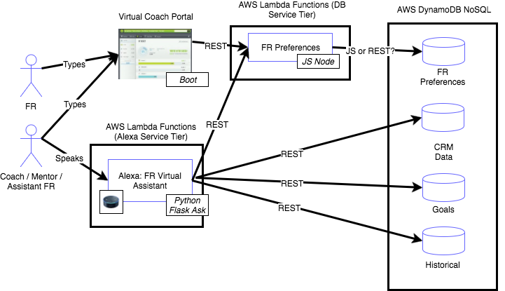
High Level Architecture
Notes:
multiple devices
Picked one here today,
In the car, wouldn’t it be nice to just talk to the bot to help out the FR

Slide 9
2nd Appendix

Slide 10
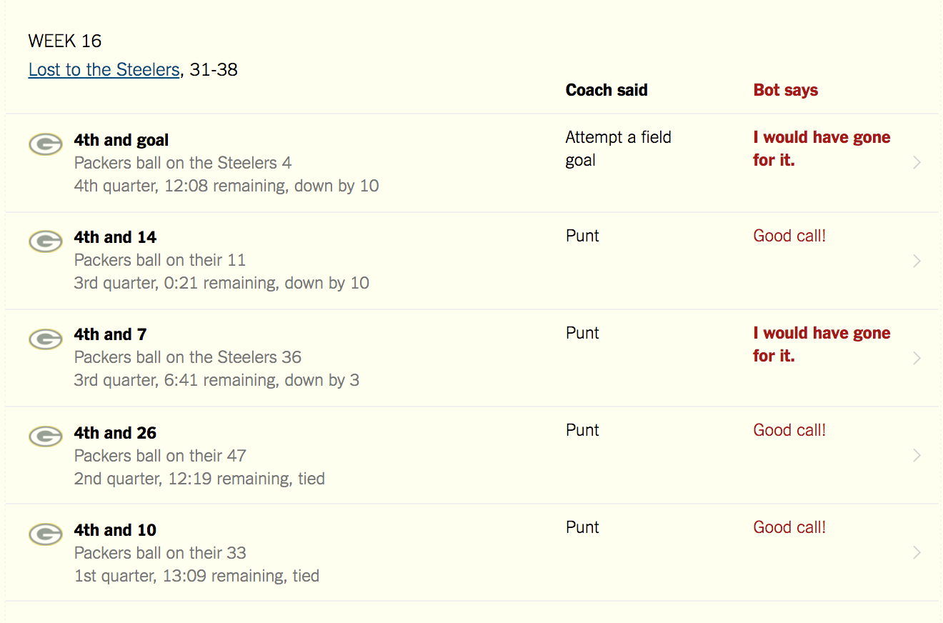
Concept : NFL and the 4th Down Bot – Sample Game
Example Game – 2013 Season – Week 16 vs. Steelers
Six tries – Two times the coach and bot disagreed on the right call
http://www.nytimes.com/newsgraphics/2013/11/28/fourth-downs/post.html

Slide 11

Hackathon Idea : NM Virtual Coach
NM needs to retain and develop young talent for our field force
Millennial FR’s need coaching and are open to using new technology such as bots
Al Granum ‘one card’ system is a proven client builder tool but how do we get Millennial FR’s to use it?
What if we developed a coach for young FR’s to help them on a daily basis feedback based upon:
One Card
Personalized feedback
Daily, Weekly and Monthly Production Goals
Gamify it to keep the Millennial FR’s coming back for more!!!

Slide 12
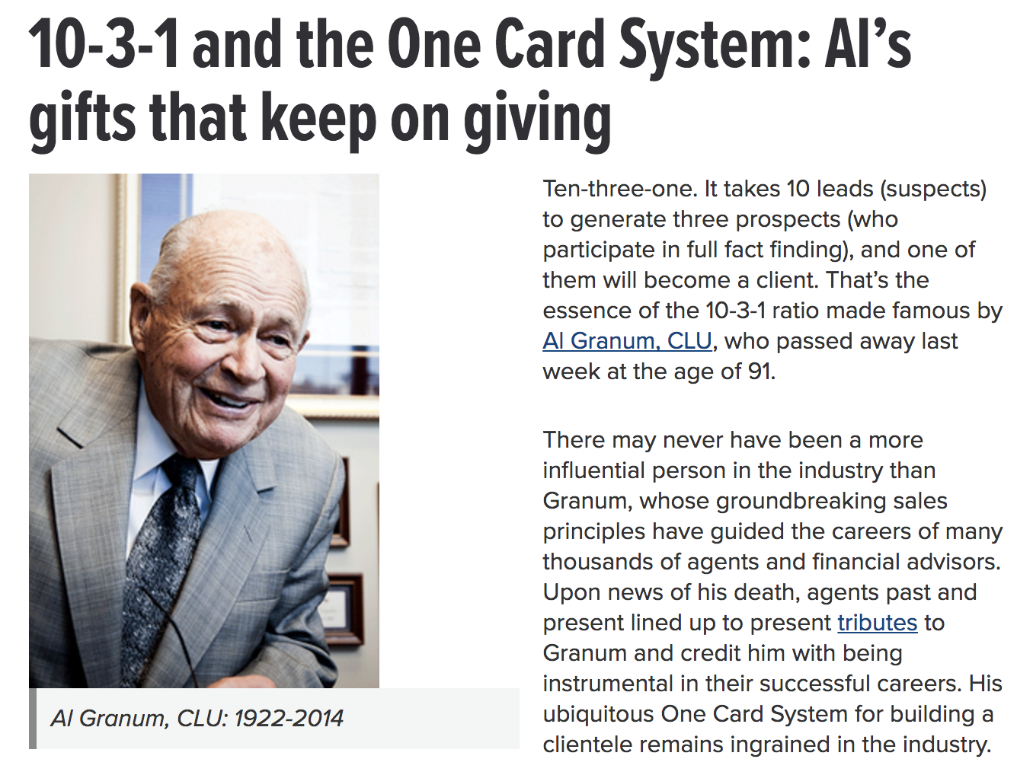
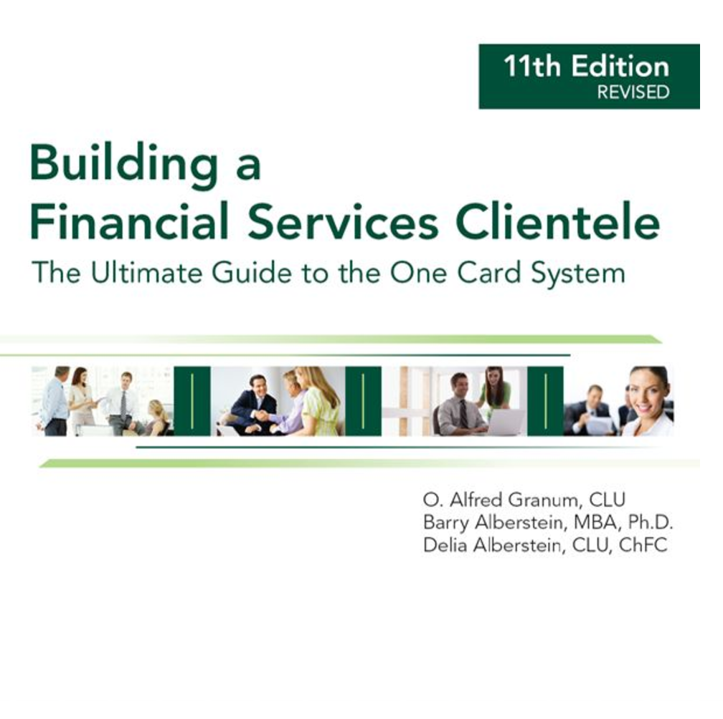
Hackathon Idea: One Card Background
Al Granum – NM Rep and creator of the One Card System
Coach FR’s Pipeline

Slide 13
Hackathon Idea: One Card Background
Research showed that every 10 leads processed would generate three prospects, and one of those would become a client. Analyzing more data compiled over the next 15 years – on 150,000 “suspects” – reaffirmed the 10-3-1 ratio. Also remarkable was that the ratio stayed the same no matter how experienced the agent became.

Slide 14
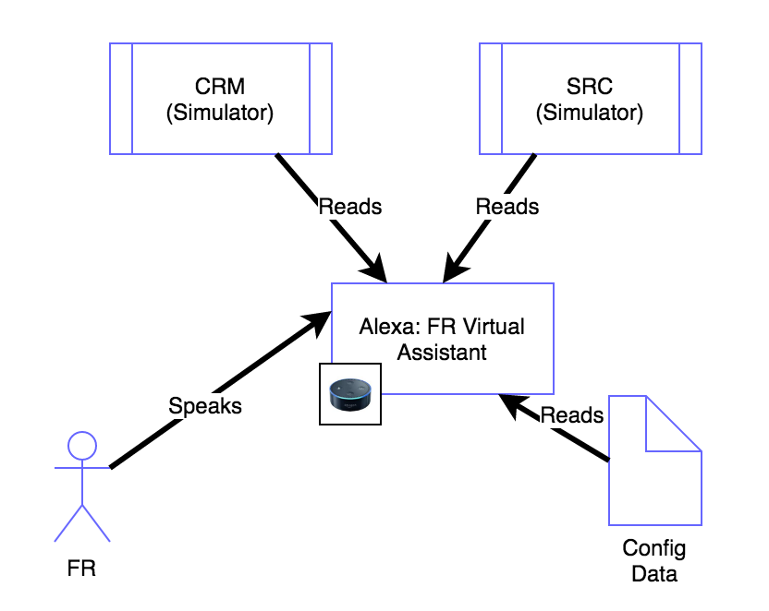
High Level Architecture (MVP)
FR does voice commands with Alexa
IT support team sets up preferences as config data
Integrations with CRM, SRC and other NM systems are used to perform various tasks

Slide 15
Tools
Alexa (actual or Amazon Developer Console tester)
Python Alexa Skill
Python, Flask, Ask Flask packages
ngrok
Reverse proxy for exposing locally running flask server for testing skills
Atom
Editor
Github
Store all code and doc in public github
Sample: https://github.com/PaulJDix/nmhack17-sample-memorygame
Don’t need NM network connection or resources
AWS Lamda function (python)

Slide 16
CI/CD
MVP
Use tools indicated to do all tests runs locally
Use Github to merge code base, single developer machine becomes prod
Rel v 2.0
Use AWS Lamda python support
Deploy code to AWS Lamda manually
Rel v 3.0
Pipeline (Frank’s CI/CD toolset except with python)
Refer to recording of Alexa lunch and learn for more details

Slide 17
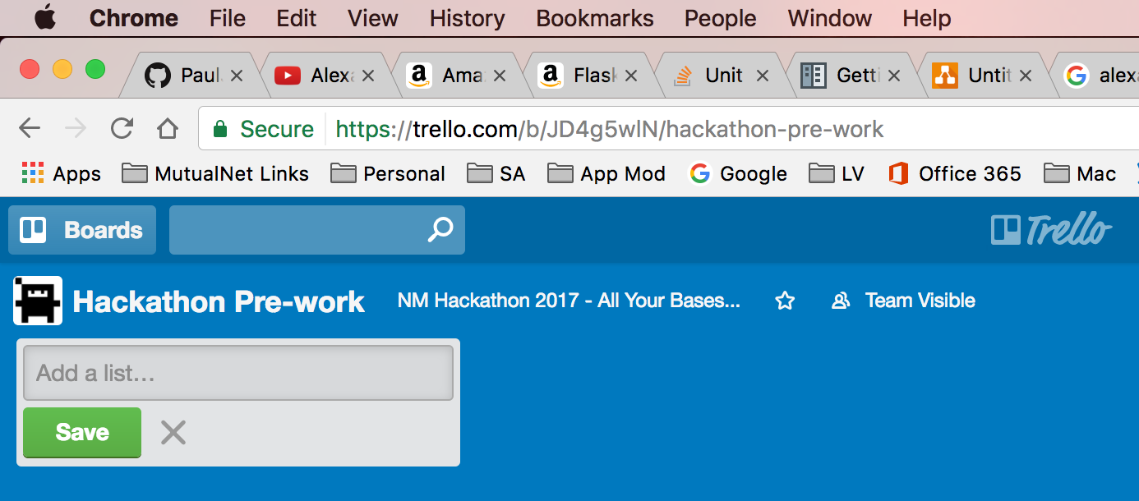
Team Tasks
Number | Task | Assigned/Status
1 | Alexa Python Service prototypes | ???
2 | Database and REST service | ???
3 | UX Flask Application | ???
4 | CI/CD Pipeline | ???
5 | Etc… | ???
Trello Board:
https://trello.com/nmhackathon2017allyourbases
Board for pre-work tasks
Board for 2 day event
Helps keep team organized
Simple, easy to use

Slide 18
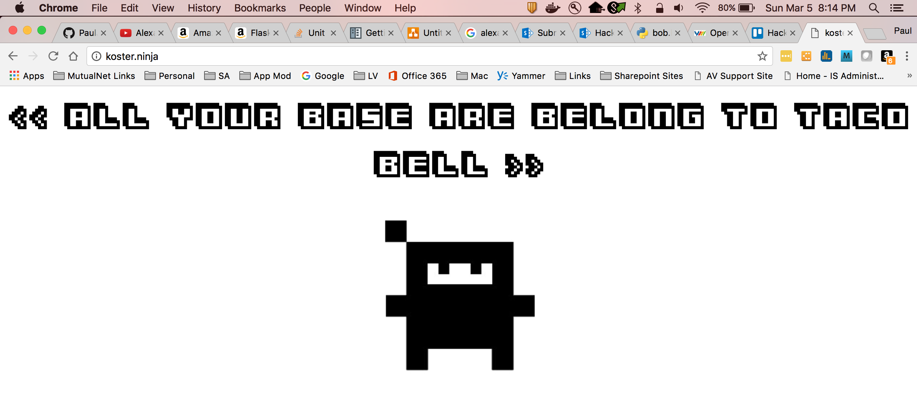
Team Name
https://en.wikipedia.org/wiki/All_your_base_are_belong_to_us

Slide 19
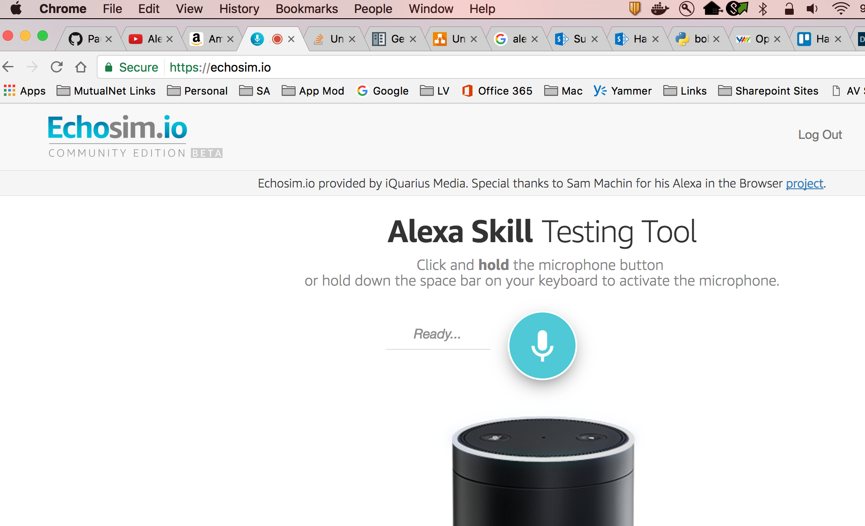
Another Testing Tool… (https://echosim.io/)

Slide 20
Idea: FR Virtual Assistant
FR’s are very busy people
They are often out of the office
They lack time to spend with their AFR’s (Assistant FR’s)
They have a lot of time where the cannot see and interact with traditional devices such as a computer or mobile device
A voice controlled bot (i.e. Alexa) can act as a AFR and…
Communicate important information
Take actions on the FR’s or AFR’s behalf
Etc...

Slide 21
Use Cases (old list)
Calendaring
Setting: Early AM, FR coming into work
Alexa reads all schedule meetings for the day so the FR does not need to open his calendar.
Service Requests
Setting: Anytime
Alexa reads all open service requests where the FR is listed as the primary or secondary rep
Underwriting
Setting: Anytime
Alexa reads all open UW cases where the FR is listed as the primary or secondary rep.
Next team meeting: Generate more ideas. What’s reasonable and doable?

Slide 22
Interviews with CRM Team (April 2017)
Discussed our teams Hackathon with CRM Bus Analysts
Ran the initial ideas we have past them
Endorsed those, refined those, etc…
Have resources that we can discuss our use cases with further
May discover a few more deals or new ideas when we speak with them further
Started 4/5 to present and till Hackathon date….

Slide 23
Use Case #1 – Appointment Assistant
Call Queue
Daily status briefing – Read off call queue for an FR for the day
Highlight A and A+ clients on this list
Follow Up Activities (CRM Workflow?)
List of follow up activities and due dates
What’s behind, status, etc….
It’s an NM Mobile App already (Posting Plus)
Can get demo of that for the team
See that and how to incorporate our bot into Posting Plus
CRM Resource: Joe Manning

Slide 24
Use Case #2 – SRC Status / CRM Opportunity Record
Status on Service Requests on A+ and A Clients
Important enough to be on their daily status briefing
CRM Opportunities Record
Tie SRC request to opportunities record
Need to research this integration for this
CRM Resource: Luke Kovarik / Joe Manning

Slide 25
Use Case #3 – Book of Business - Goals
Book of Business is…
Tracks Sales to Sales Goals for FR’s
Goals vs. Actuals
Idea: Daily status – “Did you know you two DI sales short of your goal for this month?”
Idea: Daily status – “Did you know you are in 2nd place in your region for top LTC sales this quarter?”
Discuss with BoB what are our actual use cases
Discuss how to expose these ‘Alerts’ to the Daily Status Briefing we do
CRM/BoB Resource: Kim Salmons

